Slide 1

Related Work: TMForum and ITU
Freek Dijkstra

Slide 2
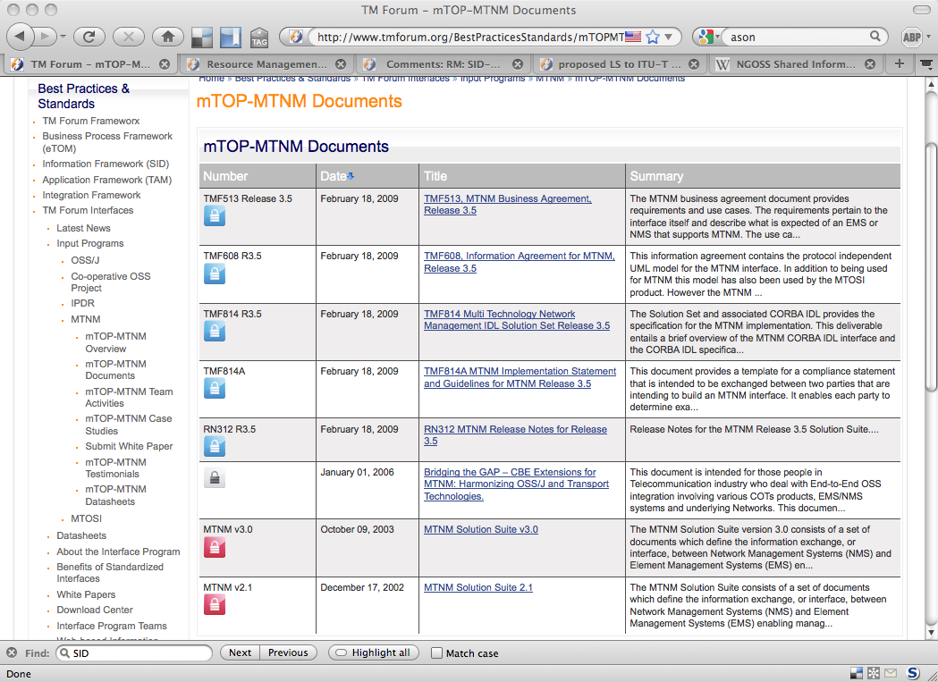
TMForum IPR Policies Apply

Slide 3
TMForum and ITU-T
ITU-T International Telecommunication Union (Standards Sector) ITU founded1865 (!); ITU-T (CCIT) founded 1925. Focus on transmission technology and telecom services.
TMForum Telemanagement Forum Founded 1984 “The voice of the OSS/BSS industry”
(OGF founded 1988; focus on grid service)
Operations & Business Support Systems

Slide 4
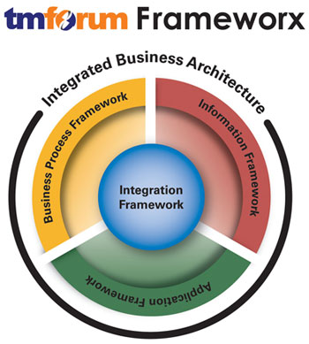
TMForum Standards
Business Process Framework (eTOM) Common vocabulary for both business and functional processes. Describes relation between service plane and business plane (long document)
Information Framework (SID) Common language and ability to align data with pertinent business processes.
Application Framework (TAM) Standardized model for grouping function and data into recognizable applications or services.
Integration Framework (TNA) Unifying function in the Solution Frameworks
Service Delivery Framework (SDF) Maintain control of service lifecycle management
IPsphere Framework Business layer for rapid service delivery

Slide 5
TMForum Best Practices
Revenue Assurance
Managing Service Quality
Certified Compliance Testing
Catalyst Program (Rapid Prototyping)

Slide 6
TMForum Software Interfaces (=API)
TMForum Interface Program (TIP)
MTOSI (Multi-Technology Operations System Interface) Interfaces for network and service management for transport networks
MTNM (Multi-Technology Network Management) Interfaces that model the management of multi-technology networks
OSS/J (Operations Support Systems / Java) Multi-technology APIs that deliver on Solution Frameworks (NGOSS (next gen OSS)) design guidelines for component-based management systems
IPDR (Internet Protocol Detail Record) Interfaces used for usage data management and accounting
Identity Management Unified identity management across operational systems

Slide 7
MTNM
UML-based interface between the Network Management Layer (NML) and Element Management Layer (EML).
Support for ATM, frame relay, SONET/SDH, DSL and Ethernet.
Business Scenarios:
Inventory Discovery
Connection Provisioning
Equipment Provisioning
Performance Management

Slide 8
TMForum Resource Management
Ensures consistency of resource descriptions between frameworks
Resources are Logical Network Resources (note: everything is logical, physical is irrelevant!)
Three tasks (2010)
ConConConvergence (Connection-Connectionless Convergence)
SID-MTNM/MTOSI Alignment
Model inspired by G.800
Integration of MTNM, MTOSI and SID models
Phase I (completed): Integrate MTNM and MTOSI and include in SID as-is.
Phase II (started sep 2009): Create a new model based on G.800
MTNM, MTOSI and SID are all UML models

Slide 9
Timeline
1994/95
G.805 v1
M.3000 (TMN) v1
2000
G.805 v2
M.3000 v2
SSIM
ATMIM
SID 1.0
2001
G.8080 v1
(ASON)
MTNM 2.0
CaSMIM
2002
2003
G.809
SID 3.0
2004
MTNM 3.0
SID 4.0
2005
MTOSI 1.0
2006
G.8080 v2
MTNM 3.5
IPNM
SID 6.0
2007
G.800 v1
M.3170
MTOSI 2.0
2008
SID 8.0
2009
2010
MTOSI 3.0
SID 9.0
2011…
G.8080 v3
G.800 v2
SID 10.0
TMF mTOP
ITU-T SG15
ITU-T SG2
TMF TIP
TMF SID
Notes:
TMN = Telecommunications Management Network
SSIM = SDH/SONET Information Model
ATMIM = ATM Information Model
CaSMIM = Connection and Service Management Information Model
IPNM = IP Network Management
MTNM = Multi-Technology Network Management
MTOSI = Multi-Technology Operations Systems Interface
SID = Shared Information/Data Model
mTOP = multi-Technology OSS Program

Slide 10
ITU-T Study Group 15
Study Period 2009-2012:
Q 1/15 Coordination of Access Network Transport standards
Q 2/15 Optical systems for fibre access networks
Q 3/15 General characteristics of transport networks
Q 4/15 Transceivers for customer access and in-premises networking systems on metallic conductors
Q 5/15 Characteristics and test methods of optical fibres and cables
Q 6/15 Characteristics of optical systems for terrestrial transport networks
Q 7/15 Characteristics of optical components and subsystems
Q 8/15 Characteristics of optical fibre submarine cable systems
Q 9/15 Transport equipment and network protection/restoration
Q 10/15 OAM for transport networks
Q 11/15 Signal structures, interfaces and interworking for transport networks
Q 12/15 Transport network architectures
Q 13/15 Network synchronization and time distribution performance
Q 14/15 Management and control of transport systems and equipment
Q 15/15 Test and measurement techniques and instrumentation
Q 16/15 Optical physical infrastructure and cables
Q 17/15 Maintenance and operation of optical fibre cable networks
Q 18/15 Development of optical networks in the access area

Slide 11
ITU-T Q12/15
Tasks in Q12/15 (Transport network architectures):
Maintenance of Recommendations I.326 and G.803
Refinement and enhancement of Recommendations G.800, G.805, G.809, G.8080, G.8010, G.8110 and G.872
Develop a revised version of Recommendation G.8110.1 to align with the MPLS-TP architecture.
Current revisions:
G.800 Unified functional architecture of transport networks
G.803 Architecture of Transport Networks based on the Synchronous Digital Hierarchy (SDH)
G.872 Architecture of Optical Transport Networks
G.8010/Y.1306 Ethernet Layer Network Architecture
G.8080/Y.1304 Automatic Switched Optical Networks
G.8110/Y.1370 MPLS Layer Network Architecture
G.8110.1/Y.1370.1 Architecture of MPLS-TP Layer Network

Slide 12
Transitional Link Concept
A transitional link consists of the link port at the edge of one subnetwork and a corresponding link port at the edge of another subnetwork that operates on different instances of characteristic information or whose characteristic information is the same but with different Layer Information. A transitional link (topological component) is supported by or implemented by layer processors and/or adaptation/termination functions (transport processing functions). A transitional link can be partitioned into parallel transitional links, or a concatenation of transitional links. It can also be partitioned into a concatenation of transitional links and zero or more links.

Slide 13
Feedback on Transitional Links
Distinguish between Transport functions and Transform functions
Transitional Link is not a new topological component
Component in a topology view for (multilayer) routing.
The described routing topology view is incomplete (e.g. it does not describe routing restrictions, which is needed for a complete view).
There may be more application specific views.
Define each derivation from topology to a specific view in a separate document
Requirement of 1:1 relation between source and sink is very limited (multiplexing and inverse multiplexing are not supported).

